Slide 1
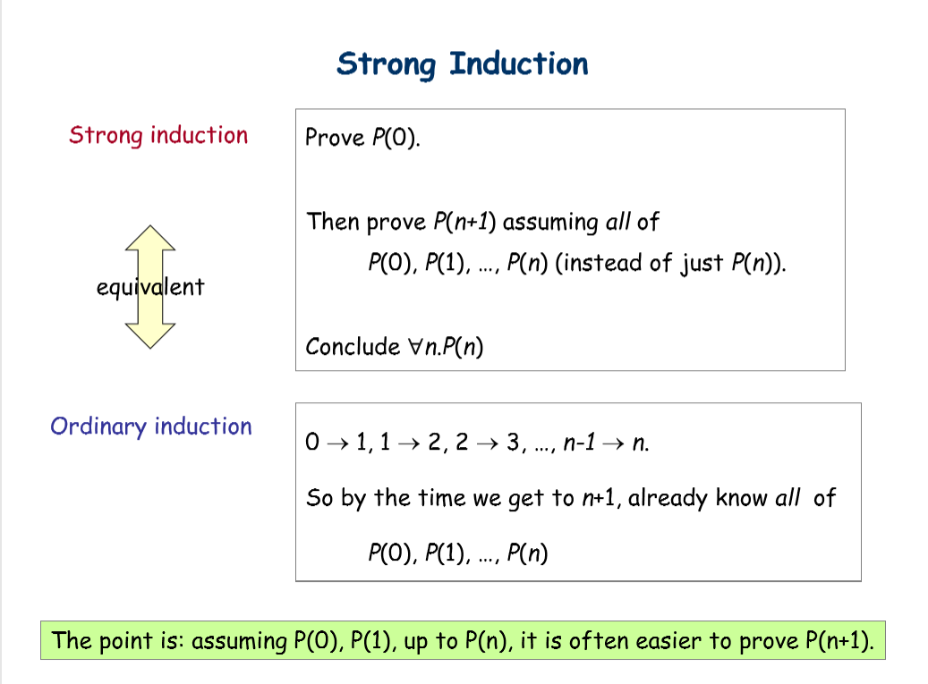

Slide 2
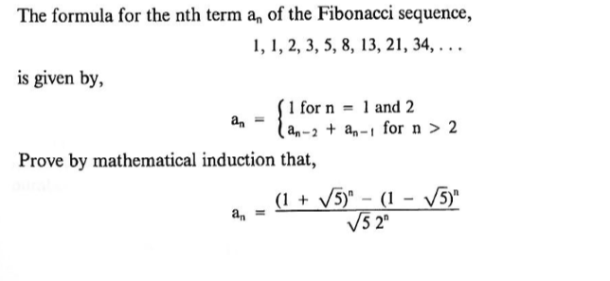
Question 1

Slide 3
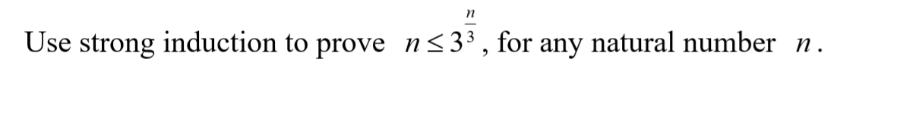
Question 2

Slide 4
Question 3
Write the numbers 1, 2, . . . , 2n on a blackboard, where n is an odd integer. Pick any two of the numbers, j and k, write | j − k| on the board and erase j and k. Continue this process until only one integer is written on the board. Prove that this integer is odd.

Slide 5
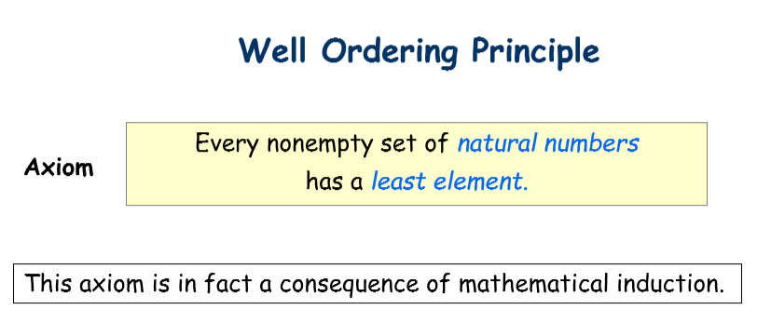

Slide 6
Question 4
Using Well-ordering Principle to show that the equation a² + b² = 3(s² + t²) has no non-zero integer solution.

Slide 7
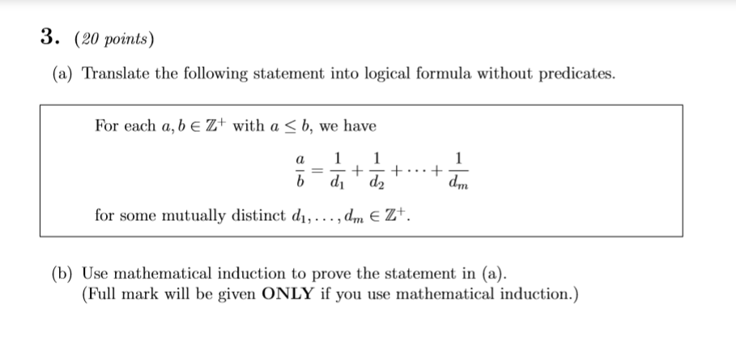

Slide 8
